Slide 1

Report on Working of Ward Committees in the City of Mumbai and Civic Problems Registered by Citizens
(March 2012 to December 2015)
April 2016

Slide 2
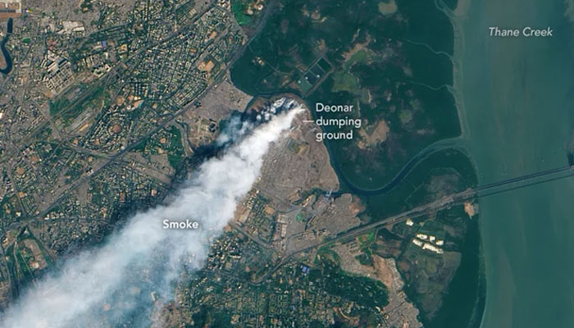
Deonar, a national embarrassment or a reason to bring some concrete change?
This satellite image has been taken from: http://goo.gl/uutKh0

Slide 3
The problem of ‘Disengaged Councillors’
Category (Ward Committee) | No. of Members
 | Mar'12 to Dec'12 | Jan'13 to Dec'13 | Jan'14 to Dec'14 | Jan'15 to Dec'15 | Average (Mar'12 to Dec'15)
Zero Question | 44 | 19 | 26 | 27 | 29
1 to 5 Question asked | 149 | 142 | 134 | 124 | 139
6 to 10 Question asked | 31 | 54 | 47 | 55 | 46
Above 10 Question asked | 3 | 12 | 20 | 21 | 13
Total Members | 227 | 227 | 227 | 227 | 227
91% of the councillors have asked less than 10 questions across the last four years
71 Councillors have asked less than 10 questions in the last four years
Ujjwala Modak (K/E ward) and Jyotsna Parmar (G/N ward) have not asked a single question across the last four years

Slide 4
Questions asked on Dumping Ground issues in the Ward Committee in the last 4 years
Year | Ward | No. of Question
2012 | M/E | 1
2013 | H/E | 1
 | L | 1
 | M/E | 1
 | S | 1
2014 | H/W | 1
 | M/W | 1
 | N | 1
2015 | S | 1
Total |  | 9

Slide 5
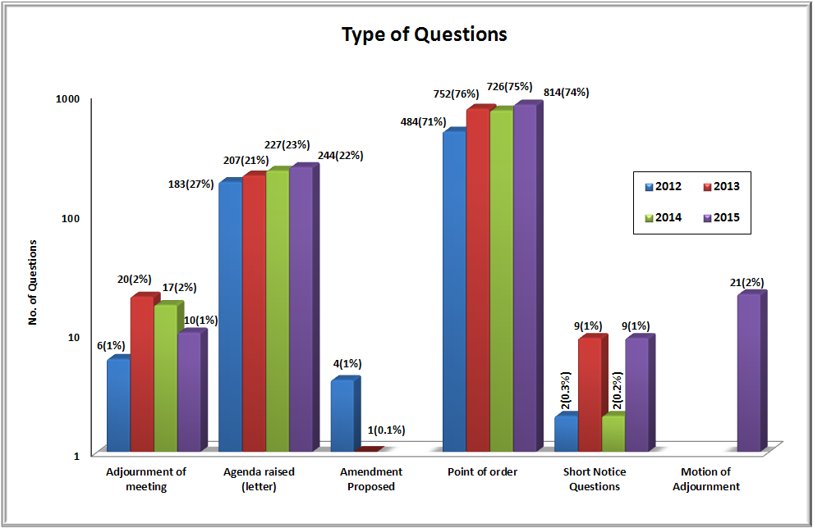
Types of devices used by Councillors in the year 2012 to 2015:
In 2015 (like in 2014), not even a single Councillor used Amendment Proposed device.
Agenda Raised (Letter) device used by Councillors increased from 227 in 2014 to 244 in 2015.

Slide 6
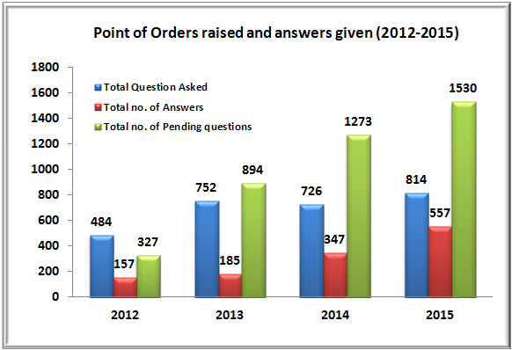
Answers given by the administration to Point of Order questions raised in Ward committee meetings in the Year 2015
The total number of pending questions has risen by approximately 5 times in the last 4 years (from 327 to 1530).

Slide 7
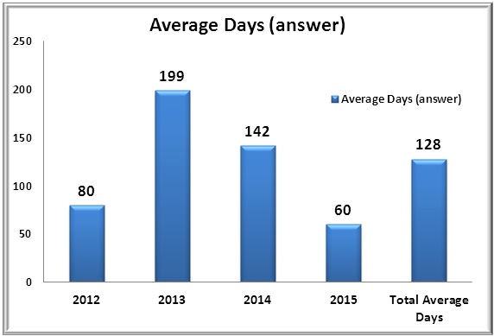
Comparison of the average days taken to answer Point of Order questions in the Ward Committees from 2012 to 2015
The average days taken to answer Point of Order questions are 128 days in the last four years. Hence, the emphasis for the administration should be now on answering the Point of Order questions.

Slide 8
Councillors holding 2 offices
Name of Councillors | MLA/MP | Party | No. of Question Asked in 2015
Ameet Satam | MLA | BJP | 0
Ashok Patil | MLA | SS | 4
Manisha Chaudhari | MLA | BJP | 0
Selvan R Tamil | MLA | BJP | 0
Sunil Prabhu | MLA | SS | 2
Rahul Shevale | MP | SS | 0
In order to give justice to any one role (Councillor/MPs) a person can only be efficient when occupying just one office.
Hence, the Mumbai Municipal Corporation Act, 1888 needs to be modified so that a person can hold only one elected office (MC, MLA or MP).

Slide 9
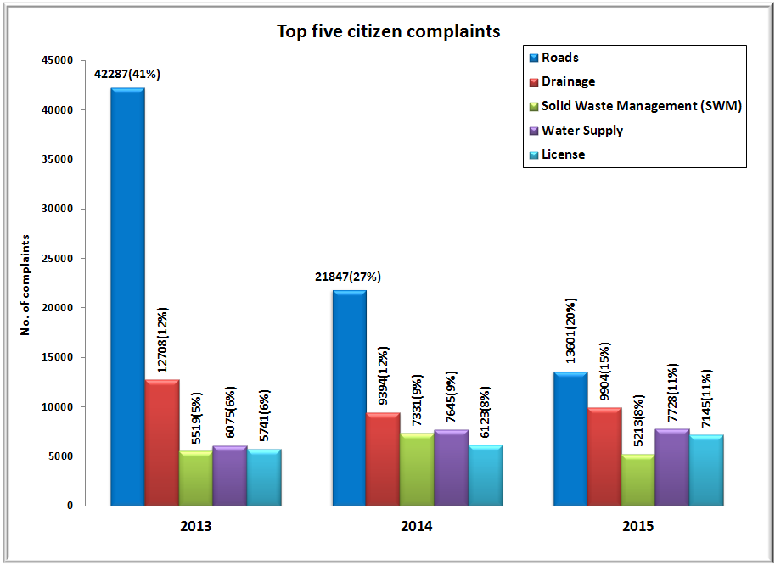
Comparison between top five citizen complaints from 2013 to 2015
The complaints registered data is obtained through RTI from the Central Complaint Registering System (CCRS) of the MCGM

Slide 10
Analysis of complaints attended (closed) in comparison with days mentioned in MCGM’s Citizen Charter
Complaint to be attended as per Citizens' Charter | To be resolved as per Citizens' Charter | Actual time taken to resolve in 2014 | Actual time taken to resolve in 2015
Drainage Chokes and Blockages | 1 | 17 | 8
Overflowing drains or manholes | 1 | 18 | 13
Odour (Foul Smell) from Drains | 1 | 16 | 14
Replacement of Missing / Damaged Manhole | 1 | 21 | 18
Raising of Manhole (except in Monsoon) | 7 | 14 | 11
Cleaning of septic tank | 7 | 19 | 16
Repairs to pipe sewers/main sewers | 7 | 20 | 18
Contaminated Water Supply | 1 | 16 | 12
Leaks in Water Lines | 7 | 17 | 14
Shortage of Water Supply | 2 | 18 | 15
Burst Water Main | 1 | 17 | 15
Garbage not lifted - Co-authorized Point | 1 | 16 | 15
Collection point not attended properly | 1 | 15 | 9
Garbage lorry not reported for service/ Lorry not covered | 1 | 14 | 9
Providing/removing/replacing dustbins | 8 | 17 | 9
Sweeping of road | 1 | 18 | 10
Removal of Dead Animals | 1 | 19 | 7
No attendance at public toilets | 2 | 18 | 11
Average Days | 3 | 17 | 13
MCGM has taken on an average 13 days in the year 2015 to address civic complaints, while the Citizens’ Charter stipulates all complaints to be resolved within an average of 3 days.

Slide 11
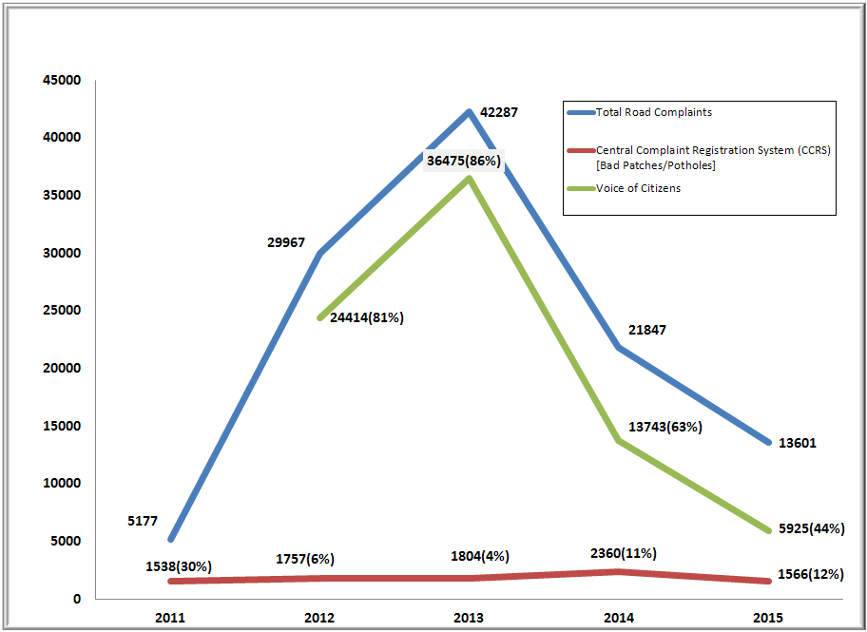
Comparison between Pothole Complaints received through Centralized Complaints Registration System (CCRS) and Voice of Citizen Online Portal:
In-spite of these figures, one out of every seven questions asked by Councillors in ward committee meetings pertain to issues on ‘Renaming of Roads/Chowks’.

Slide 12
Wards affected most by the poor redressal of civic complaints:
87 days taken to resolve ‘Repairs to Pipe Sewers/ Main Sewers’ complaints in F/N ward.
85 days taken to resolve ‘Burst Water Main’ complaints in G/S ward.
62 days taken to resolve ‘Leaks in Water Lines’ and 46 days taken to resolve ‘Shortage of Water Supply’ in M/E ward.
59 days taken to resolve ‘Odour (foul smell) from drains’ complaints in R/C ward.
43 days taken to resolve ‘Replacement of Missing/Damaged manhole’ and 30 days taken to resolve ‘Overflowing drains or manholes’ complaints in H/E ward.
P/N ward took 32 days to resolve ‘Garbage not lifted from co-authorized point’, 21 days to resolve ‘Garbage lorry not reported for service/lorry not covered’, and 17 days to resolve ‘collection point not attended properly’ complaints.

Slide 13
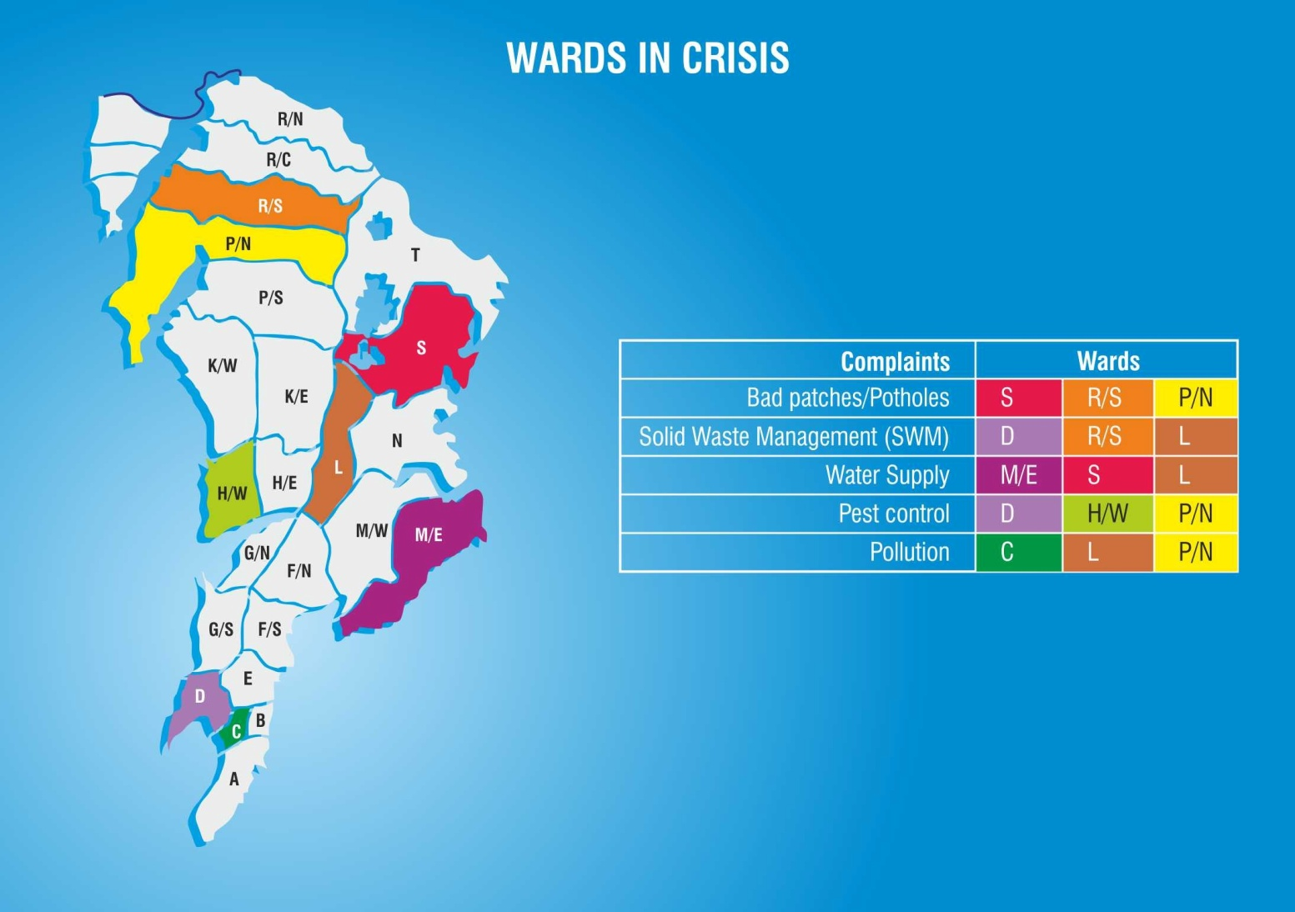
Wards in Crisis (1/2)
The complaints data for Roads, Drainage, Water Supply and Solid Waste Management has been plotted for the years 2016 to 2018 using time series analysis on data from 2008 to 2015. As per this data, we have computed wards that will be worst affected in the next three years.

Slide 14
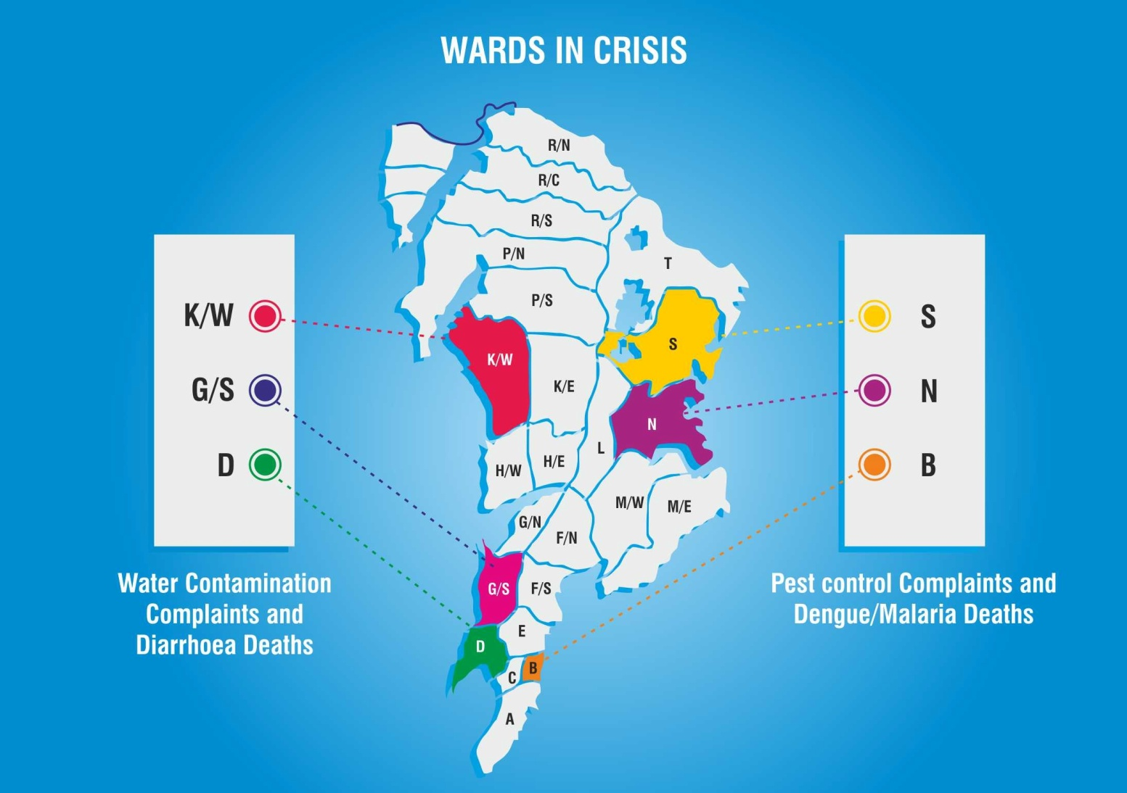
Wards in Crisis (2/2)
The complaints data for water contamination complaints and diarrhoea deaths as well as Pest control complaints and dengue/malaria deaths has been plotted for the years 2016 to 2018 using time series analysis on data from 2008 to 2015. As per this data, we have computed wards that will be worst affected in the next three years.

Slide 15
The Way Forward
Functioning of Ward Committees needs to be seriously improved. This can only be done when councillors instrument effective deliberation during ward committee meetings, on constituency-wise civic issues, using the appropriate devices at hand.
Councillors need to study civic issues pertaining to their constituency, then prepare agendas and push these in the committee meetings in a planned manner.
Councillors also then need to follow up with the administration regularly and demand answers on pertinent issues.
Councillors could also demand monthly reports on the status of citizens’ complaints in the ward committee meetings from the administration, which would ultimately lead to more accountability within the administration.
The administration also needs to start taking ‘Point of Order’ questions seriously, and answer them preeminently.
For there to be any concrete change, the administration needs to change from within, which can only happen when the administration becomes proactive and embodies good governance practices.

